Slide 1


How to Close 32% More Sales
& Build a Firm Full of Your
Ideal Clients

Slide 2
DO YOU FEEL LIKE…
You have a lead problem, and everything would be fine if you could just get more leads?
You have new or existing clients that don’t appreciate you, or you provide them way more value than what they’re paying you for?
You are stressed about money or cash flow so you take on clients you don’t really want to work with, or discount your fees just to get a YES?
You feel overworked and underpaid, and know it’s time to increase your rates but worry people won’t pay you more?

Slide 3
POLL: Which of these is the biggest challenge in your firm right now?
Not enough quality leads
Clients don’t value me or I undercharge
Working too hard for too little money
Taking on clients I don’t really want to work with

Slide 4
There are 5 steps you must do to attract your ideal clients and easily get them to engage…all while charging the premium fees you know you deserve.
Shift summary/one-liner
This process is the backbone of a successful firm.

Slide 5

Why You Should Listen to Me
I’ve helped hundreds of accounting, tax, and bookkeeping firm owners double their firm revenue and gain time freedom by a process that I spent 20+ years perfecting.
Our clients have collectively increased their revenue over $20 Million from their base revenues.
When it comes to helping firm owners confidently present and get paid for monthly bookkeeping, tax and CFO services, we are the best at what we do.

Slide 6
Shift summary/one-liner
STEP 1:
Know Your Value
This process is the backbone of a successful firm.

Slide 7
Step 1: Know Your Value
Low prices, charging hourly, trying to beat competitors, or giving discounts are all undervaluing your knowledge, experience, and expertise
In reality people pay you for the RESULTS you deliver
Higher fees actually show that you are the expert, and will help you confidently update your services to lead with advisory services and ways you help save the client money in taxes or future potential mistakes. That communicate real ROI on your fees
Charging for the results you deliver allows you to gain back time and freedom without losing any money

Slide 8
Step 1: Know Your Value
List out your strengths, experience, and accomplishments
How many hours did you spend getting your degrees?
How much time do you spend getting CPE’s
Compile stories and testimonials from people you have helped and what results have you gotten for them - BONUS if you can add up $ amounts of how much you’ve saved them!
Think about how much time, money, and energy you have spent to get to where you are today.

Slide 9
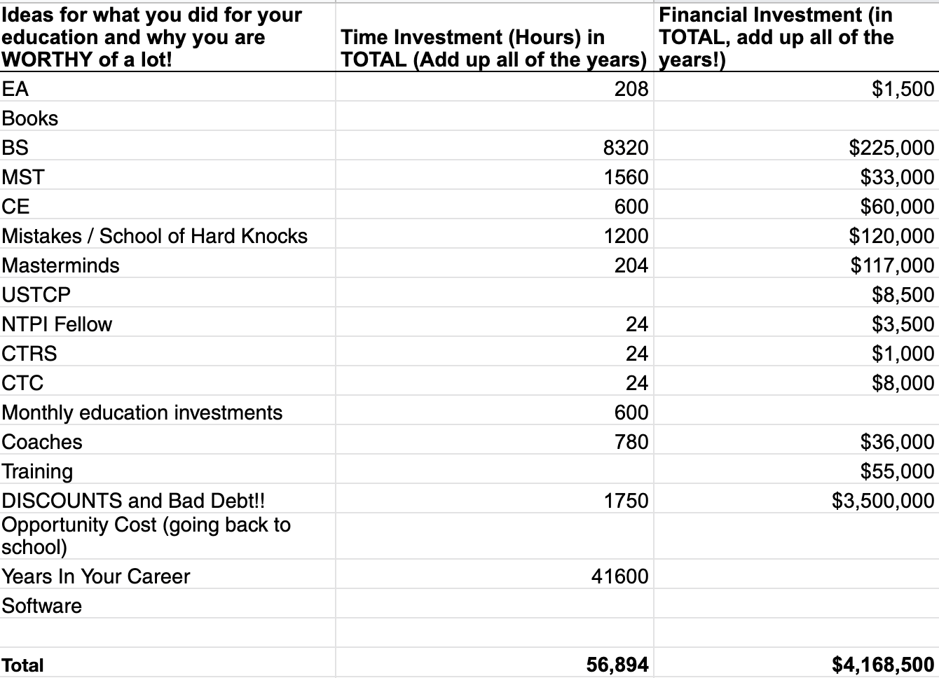
What Are You Really Worth?
Formal Education - Degrees, Certifications, CPEs
Years of Business and Career Experience
Speaking/Community Involvement
Industry Research and Niche Expertise
Online Presence and Participation
School of Hard Knocks
Personal Development - Books, Podcasts, Courses, Coaching

Slide 10

Download the Values Exercise Template
https://theabundantaccountant.com/values

Slide 11
Step 1: Know Your Value
Your clients and potential clients have a MASSIVE problem that will not get solved by itself. They want and need to pay you to solve their problem!
You are the expert and they need YOU, not the other way around
Your expertise and knowledge is your most valuable asset. It’s time to stop wasting your time being a bill collector or working with clients that don’t appreciate (or simply aren’t a fit) for what you do
Sending proposals, quotes, and invoices and working with low quality, low paying clients is your #1 time and money waster

Slide 12

Our Real Clients Results …
This works in Just About Every Type of Firm You Can Imagine…
Felt like a hamster on a wheel, as tired of not seeing her family and not being able to attend her kids' events on weekends
Making small changes hadn't done anything to get her firm where she wanted it to be
We helped her realize her worth and put herself first
She collected $67,000 in accounts receivable and had wins of $20,000 over what I would have charged or did charge in the prior year, and gets paid upfront for everything
She NOW has the work/life balance she dreamed of having when she started her firm
Olga

Slide 13
Shift summary/one-liner
Knowing your value and knowing who qualifies to work with you is the MOST important step to creating the firm you really want.
This process is the backbone of a successful firm.

Slide 14
Shift summary/one-liner
STEP 2:
Know Your Ideal Client and Who Qualifies to Work with You
This process is the backbone of a successful firm.

Slide 15
HAVE YOU EVER…
Taken on a client that wasn’t a fit for you?
Charged less than you’re worth or given a discount?
Taken on a client because you’re stressed about money?
Continued working with a client that drives you crazy?
Have long-term clients that have never had their rates raised?
Done extra or unexpected work that you didn’t charge for?

Slide 16
POLL: How many of your current clients would you consider your “ideal clients”?
Less than 25%
25–50%
50–75%
75–100%

Slide 17
DID YOU KNOW…
You DO NOT have to work with whoever is in front of you…and you shouldn’t want to either!
The temptation to accept every client that comes your way is NOT worth your time, energy, & missed opportunities. Success comes from an abundance mindset, setting boundaries, and having a clear vision for your firm.

Slide 18


Think about it…
Would an oral surgeon take on a client that just needed a teeth cleaning?
Would a brain surgeon see a patient that just had a head cold?
Should YOU take on clients that don’t match your expertise or vision for your firm?

Slide 19
Your Ideal Client
We want to speak to a specific client with specific goals and dreams.
The more you know about what your clients want and why they want it, the more your message will reach those types of clients and the easier it will be to communicate your value to them.

Slide 20
Your Ideal Client
Setting clear boundaries in your firm will allow you to take your power back and get the RIGHT clients who will pay you premium fees UP FRONT.
My ideal accounting or bookkeeping client is ready to take action now.
I only work with businesses who have more than $200k in annual revenue.
I only work with clients who engage in ongoing services.
I only work with clients in X industry.

Slide 21
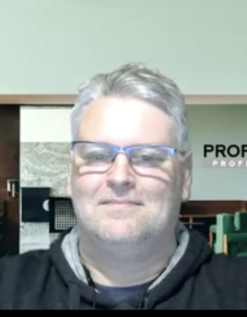
Our Real Clients Results …
This works in Just About Every Type of Firm You Can Imagine…
Had no process to qualify clients and would take on anyone, and had too many low quality clients at low fees
Using our proven system, Peter stopped underpricing and taking on clients that weren’t a fit for his firm
He learned how to qualify and communicate with clients and increased his fees by 50%!
In just 8 weeks, Peter added $4,000 in monthly recurring revenue and added $10,000 in other revenue for services he wouldn’t have even charged for before
Peter

Slide 22
Shift summary/one-liner
STEP #3:
Create a Different Experience
This process is the backbone of a successful firm.

Slide 23
Create a Different Experience
Your ideal clients want and need a completely different experience. If your ideal is a $1M business, you can’t be the “typical” firm.
Technical expertise and “good service” isn’t enough
If you're just winging it or doing what everyone else is doing, you’re going to get results similar to what everyone else is getting.
Have an abundance mindset and be willing to say NO to new and current clients that are not a fit for you or are unwilling to follow your process

Slide 24
Create a Different Experience
A sales conversation is an exploration, not an interrogation with pushy sales tactics.
Be genuinely curious and ask strategic questions to get to the root of the problem, and then share your solutions towards the end of a meeting if YOU feel they are a good fit for you.
When this is done correctly, the client will see your value and know that you are the exact person they need.

Slide 25
Don’t Forget the Basics!
Relax, smile and be yourself.
Be prepared and stop winging it.
Put yourself in the client’s shoes.
Be interested in the client but be invested in your skills.
Listen more and talk less.

Slide 26

Ask the Right Questions
Show your clients and prospects that you understand their pain points by asking the right questions. This will gently guide your clients to see the reality of their situation (and that they need YOUR help).
When you give a prospect an accurate diagnosis of their problem in layman terms, they will believe YOU have the solution.

Slide 27
Get to the Real Why
There’s a reason and a why (pain) for the person coming to you in the first place.
Then there’s always a “why” behind the “why.” The more layers you can peel back to understand the pain, the closer you can get to your client’s REAL why.
Getting to their REAL why is usually the difference between someone saying YES or saying NO.

Slide 28
Focus on RESULTS
Focus on the RESULTS for your clients, not the process or the how.
Most firm owners try to prove their experience or expertise with fancy jargon or number crunching. Don’t do this!
Speak to your clients in terms of the RESULTS you will get them. Bring the focus back to the potential client, the problems they’re facing, and the results you can help them achieve.

Slide 29
When you know your ideal client, ask the right questions, give an accurate diagnosis, and focus on the RESULTS you will get, they will believe that you have the best solution for them…and they will be willing to pay premium fees for it!
Shift summary/one-liner
This process is the backbone of a successful firm.

Slide 30
Shift summary/one-liner
STEP #4:
Protect Your Inventory
This process is the backbone of a successful firm.

Slide 31
The Truth About “Quick Questions”
How often does a “quick question” or doing something “additional” come up where it takes you a ton of extra time, that you’re not being paid for?
Giving your time and expertise away for free will NEVER get you the results you want. You will end up feeling used, undervalued, and working too hard for people who are not a fit for you.

Slide 32
POLL: How much time per week do you spend doing work for free?
This includes taking calls, responding to emails/“quick” questions, doing research, sending invoices/payment reminders…
None!
1-5 hours
6-10 hours
More than 10 hours

Slide 33
Whether you’re speaking to a prospect or your oldest, most loyal client…
you MUST stop giving away your time & expertise for FREE!

Slide 34
How to Protect Your Inventory
You must create boundaries around your time and expertise!
Stop giving out bandaids and free advice
Qualify your prospects
Collect the right information & ask the right questions
Charge outright for phone calls, emails, “quick questions” or build in them into your prices/packaging. There is a price to access you!
Use engagement letters to clearly outline what’s included (and what’s not)

Slide 35
Think About It…
If you visit the doctor, how does the doctor know what’s really going on? The doctor asks specific questions to get the information they need to make a diagnosis. Just like a doctor does, you have to strategically poke around to discover the true pain. It’s time to do a tax diagnosis!

Slide 36
Getting ALL the Information
There’s no way to actually help someone AND get paid appropriately unless you know all the details of their situation!
Getting ALL the information before you do any work also increases your value in the prospect’s eyes and eliminates price shoppers. You are the expert and you are in control!

Slide 37
Why Engagement Letters?
Having what is included and what is NOT included eliminates any confusion for you AND the client about what is being provided and how it’s being delivered
Let the numbers and what is in writing (not you) do the talking! When you show the true scope and value of what you do it’s always easier to name your price and get paid for your worth and never have scope creep
Have it signed BEFORE you do any work!
Include regular meetings or regular follow up to ensure needs are being met and be able to anticipate scope creep ahead of time

Slide 38
Think about the Doctor Again…
How would you feel if a doctor gave you a diagnosis and prescription WITHOUT asking you for additional information or looking at your X Rays, MRI or CT scans?

Slide 39
You can easily filter out price shoppers, tire kickers, or clients that don’t appreciate you when you start implement these kinds of boundaries in your firm. They will set you apart, helps build trust and authority, and shows your clients and prospects your value.

Slide 40
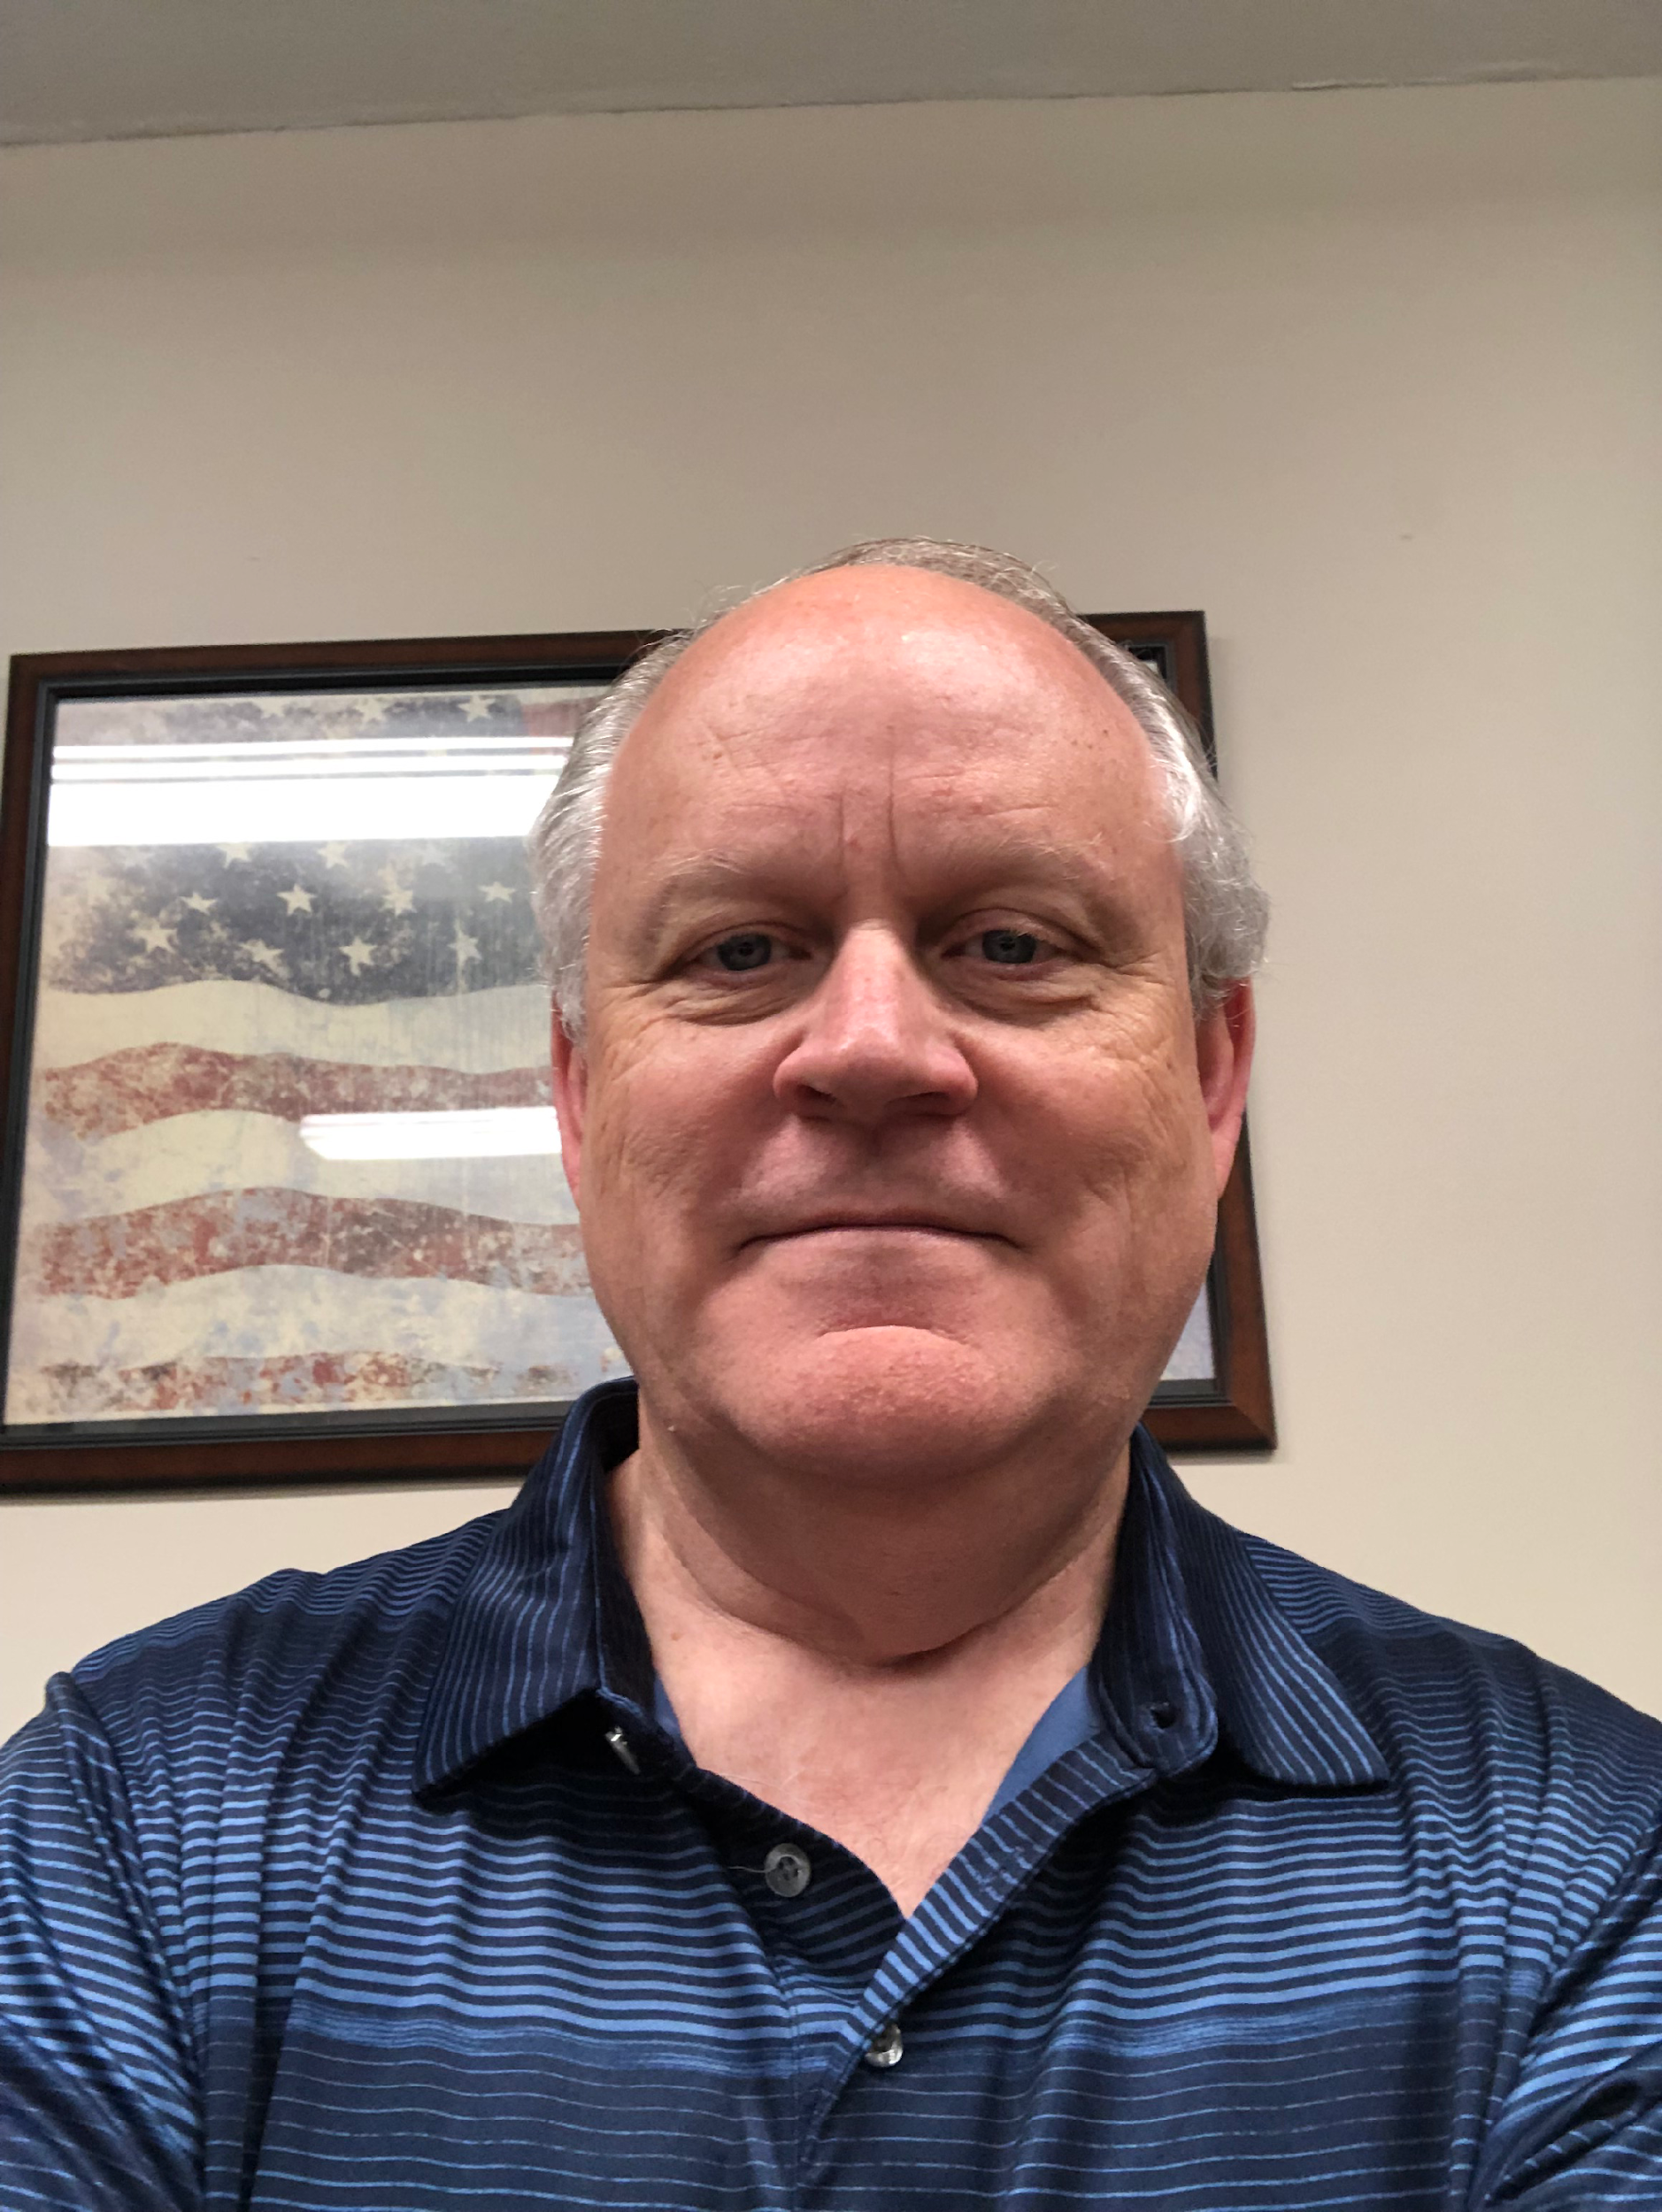
Meet Tommy…
He was burnt out, attracting the wrong clients, and working harder each year but never meeting his goals
Felt like he was doing the same thing over and over and getting no results
He enrolled in our program and quickly began billing for services previously done for free, adding $10k in additional revenue in just 8 weeks!
He collected on his old debt and got his A/R to $0 and now gets paid upfront before starting an engagement.
He now spends more time with his family taking trips and his business is not suffering!

Slide 41
Shift summary/one-liner
STEP #5:
Be Prepared &
Have a System in Place
This process is the backbone of a successful firm.

Slide 42
POLL: Do you currently have a clear, repeatable process for sales conversations?
Yes, fully documented and repeatable!
Kind of…but don’t always stick to it
Not really, I mostly “wing it”
No, I dread sales conversations

Slide 43
Shift summary/one-liner
“Winging it” is costing you time, money, stress AND your ideal clients.
This process is the backbone of a successful firm.

Slide 44
Be Prepared & Have a System
The OLD Way
Don’t know what to charge & wing it with every client
Give discounts, negotiate or justify your fees
❌
Get as many clients as possible
❌
❌
Ignore A/R, & cross your fingers to hope clients will eventually pay
Send a proposal/quote & wait for a response
Waste time chasing clients for payment
❌
❌
❌

Slide 45
Be Prepared & Have a System
Not having a system in your firm is costing you time, money, stress, AND clients.
Implementing a sales system in your firm allows you to engage your ideal clients and charge fees you’ve never thought were possible to charge
It also allows you to get paid upfront by giving them confidence that you are providing them results they can’t get from anyone else.
Without a system in place, you will end up overworked, underpaid, and burnt out!
When you have a system and a process, you just have to repeat the steps. No more reinventing the wheel with every client!

Slide 46
The 3 P’s: Price + Present = Payment Upfront
PRICE
PRESENT
GET PAYMENT
UP FRONT
Figure out EXACTLY what to charge before the meeting, package your services & price based on VALUE
+
Present your findings and services in a very specific way so clients see your value
=
Because clients feel 100% confident you will deliver results

Slide 47
Shift summary/one-liner
You can eliminate 90% of the time wasting strategies you’ve been doing, and replace it with this step-by-step system.
This process is the backbone of a successful firm.

Slide 48
BONUS STEP: Invest in Mentoring
As simple as this is, there are a million ways to mess it up.
Why try to figure it out on your own when someone can just hand you the answers?
I have helped over 389 accounting, fractional CFO, tax and bookkeeping firm owners quickly grow their firm revenue, eliminate all A/R, all without the stress & burnout.
We turned their firms completely around so that they can actually have relaxed success and go on vacations that they use to only dream about before.

Slide 49

My team and I have set aside some time in the next 48 hours to speak to you personally about how you can apply these ideas to your firm starting TODAY.
www.theabundantcall.com

Slide 50
Our goal on this call is to give you massive clarity.

Slide 51
On the Call, Our Goal Will Be to Get You Crystal Clear on Four Things…
Where you want your firm to be and how you can get there quickly and avoid ALL the potential pitfalls along the way.
WHO are your dream clients? Who are those dream clients who will happily pay you 200%-300% more for your work?
The EXACT price you should be charging. What’s the magic number that will bring in the most revenue?
The EXACT formula you should follow to confidently enroll those clients at your new premium fees, get paid upfront, all while reducing your workload

Slide 52

Click Below to Grab Your Spot!
www.theabundantcall.com

Slide 53
Shift summary/one-liner
Q&A
This process is the backbone of a successful firm.

