Slide 1
The Simple Firm
A Blueprint for Clarity, Freedom, and Growth
Darren Root: November 5, 2025

Slide 2


Darren Root
Author, Entrepreneur & Teacher
Root Advisors - CPA Firm for 35 Years
Rootworks - Founder, Over 1,000 Accounting Firms for 15 Years
CPA Practice Advisor Magazine - Executive Editor for 7 Years
The Simple Firm - Author 2025
The Intentional Accountant - Author 2014
The E-Myth Accountant - Co-Author 2011
Accounting Today Top 100 - for Over 10 Years
Copyright 2025

Slide 3
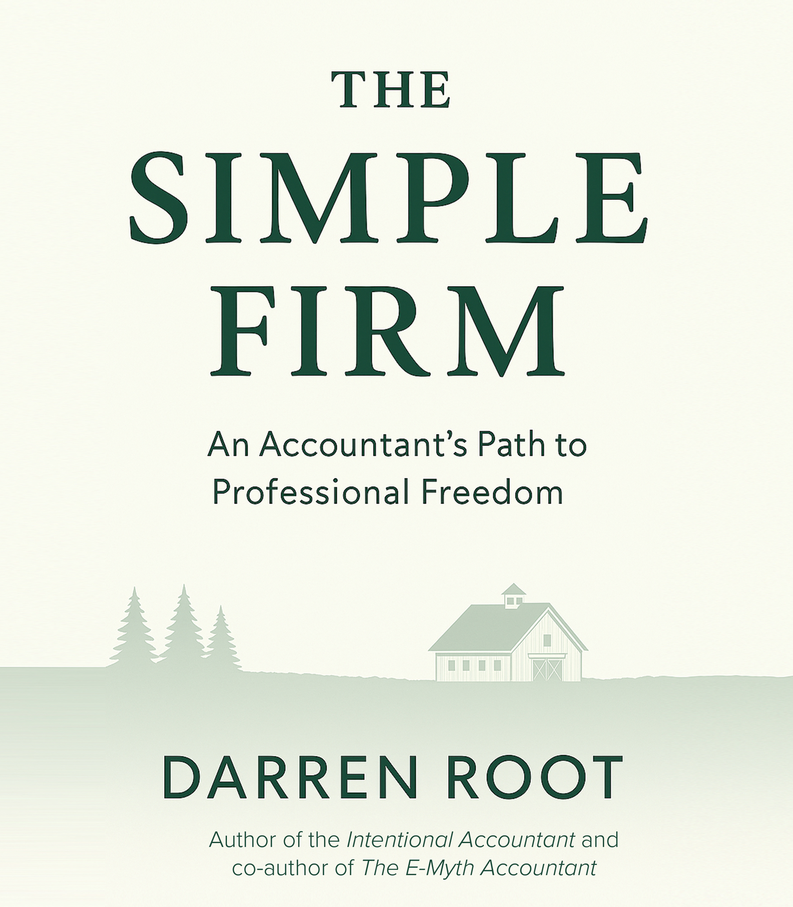
Amazon
Hardback
Softback
Ebook
Audible
Copyright 2025

Slide 4
The Simple Firm
An Accountant’s Path to Professional Freedom
Freedom of Time
Freedom of Money
Freedom of Relationships
Freedom of Purpose
Copyright 2025

Slide 5
Polling Question #1
Do you currently feel like you have the professional freedom you desire from your business?
Yes, definitely
No, work is consuming
Copyright 2025

Slide 6
3 Keys to Professional Freedom
Define a focused business model.
Build a roadmap for holistic client service.
Simplify technology and reduce friction.
Copyright 2025

Slide 7
“Most firms weren’t built intentionally—they evolved reactively. But clarity and simplicity are where freedom begins.”
Copyright 2025

Slide 8
Define a Focused Business Model
Copyright 2025

Slide 10
Sara Berman’s Closet
Copyright 2025

Slide 11
Symptoms of Complexity
Overextended service list.
Misaligned clients.
Burned-out teams.
Bloated technology stack.
Copyright 2025

Slide 12
“Complexity steals freedom. Clarity creates it.”
Copyright 2025

Slide 13
“If your business runs your life instead of serving it—it’s time to simplify.”
Copyright 2025

Slide 14
Polling Question #2
Do you have the level of simplicity you desire in your firm?
Yes, definitely
No, our firm is complicated
Copyright 2025

Slide 15
Foundation 1: Define Your WHAT
Copyright 2025

Slide 16
Compliance Essentials + Strategic Advisory
Copyright 2025

Slide 17
Compliance Essentials
Core services where 85% of the work is done using machine learning and AI tools
Accounting Services
Payroll Services
Tax Services
Copyright 2025

Slide 18
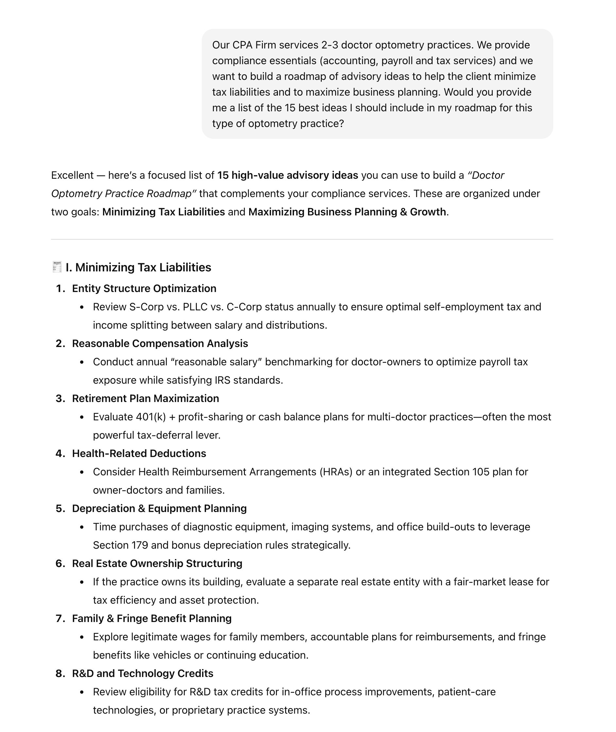
Strategic Advisory
Building your roadmaps becomes your
intellectual property
Copyright 2025

Slide 19
Strategic Advisory Services
Holistically serving your clients by filling the gaps
Comprehensive Planning Roadmap - the lifetime view of all potential planning topics for a client type. It keeps the firm intellectually deep and ensures nothing gets missed over the course of a relationship.
Annual Planning Roadmap - a cadence of quarterly touchpoints—Q1 tax results review, Q2 planning idea, Q3 tax projection, Q4 year-end planning and technology review.
Copyright 2025

Slide 20
“When you simplify your offerings, you give your team clarity and your clients confidence”
Copyright 2025

Slide 21
Defining your WHAT is the first step toward freedom
Copyright 2025

Slide 22
Foundation 2: Define Your WHO
Copyright 2025

Slide 23
Ideal Client Profiles
Your WHO determines your systems, your team’s rhythm, and your sanity
ICP - by fluency (who do you and your team like serving)
ICP - Industry (from broad to more narrow)
ICP - Client types (high net worth 1040’s, retirees, etc)
ICP - by fit (technology, advice, pay on time)
Score your clients - track in your firm operating system (A, B, C)
Copyright 2025

Slide 24
Who drains your energy vs. who fuels your firm?
Copyright 2025

Slide 25
“When you stop chasing volume and start curating value, your firm transforms.”
Copyright 2025

Slide 26
Polling Question #3
Has your firm developed roadmaps for your Ideal Client Profiles?
Yes, completely
Yes, somewhat
Not yet
No, we are still unclear on who our ICP’s are.
Copyright 2025

Slide 27
Foundation 3: Define Your HOW
Copyright 2025

Slide 28
Your HOW is your operating system—the process, the people, and the technology that deliver consistency.
Copyright 2025

Slide 29




ARTIFICIAL INTELLIGENCE
Firm Operating System
Production
Social Media
Client Portal & Mobile App
COMPLIANCE
CLIENT FACING
Website
E-Signatures
Onboarding
Client Communication
Document Exchange
Invoices & Payments
Client Accounting
Prospect Vetting
Document Management
Time & Billing
ADVISORY
ARTIFICIAL INTELLIGENCE
Scheduling
ARTIFICIAL INTELLIGENCE
INTERNAL
CRM
Workflow
ADVISORY
Payroll
Reporting
Team Management
Tax
INSIGHTS
Client
Scoring
Client
Upsell
Employee Scoring
Employee Wellness
HR & Legal
ARTIFICIAL INTELLIGENCE
Copyright 2025

Slide 30
How will teams and roles evolve in an AI world?
Copyright 2025

Slide 31
Current Roles:
Bookkeepers
Payroll Specialists
Preparers
Client Managers/Reviewers
Administrative Staff
Partners/Owners
Copyright 2025

Slide 32
From Bookkeeper, Payroll Specialist and Tax Preparer
To A Curator
Copyright 2025

Slide 33
Curators — professionals who ensure that what AI produces is correct, relevant, and usable.
Copyright 2025

Slide 34
From Reviewer and Client Manager
To Advisor
Copyright 2025

Slide 35
Advisor — the client’s strategic partner — responsible for interpreting data, anticipating needs, and guiding the client’s next steps based on a clearly defined roadmap.
Copyright 2025

Slide 36
From Administrative Staff
To Experience Designer
Copyright 2025

Slide 37
Experience Designer — people who think deeply about how clients and team members experience the firm.
They don’t just react to needs; they design moments that create confidence, calm and delight.
In short: AI handles the process — our people craft the experience.
Copyright 2025

Slide 38
Automation Architect — identifies, designs, and implements automation across the firm’s systems and workflows.
Their goal isn’t just to make processes faster — it’s to make them simpler, smarter, and more consistent.
In short: they ensure each process aligns with the firm’s model, tech stack, and client experience goals.
Copyright 2025

Slide 39
Future Firm Structure
Leadership
Automation Architect
Automation Layer
→
Curation
Layer
→
Advisory Layer
→
Experience Layer
Automation Architect
Leadership
Copyright 2025

Slide 40
Polling Question #4
Which statement below best describes your firm’s technology stack?
We have a clearly defined, efficient technology stack
Our technology stack is too bloated with disconnected tools
We really struggle moving into the modern era with new technologies
Copyright 2025

Slide 41
The Simple Firm Flywheel
Focused Business Model
Right Clients
Streamlined Delivery with Firm Operating System
Team Clarity & Capacity
Freedom — fuels intentional growth
Copyright 2025

Slide 42
The Simple Firm
An Accountant’s Path to
Professional Freedom
Freedom of Time
Freedom of Money
Freedom of Relationships
Freedom of Purpose
Copyright 2025

Slide 43
Darren Root
Author, Entrepreneur & Teacher
bettereveryday.com
thesimplefirm.com
darrenroot.com
Signup for our free newsletter (One Big Idea)
Check out The Simple Firm Book on Amazon
Copyright 2025

